Slide 1
Functional Dependencies and Schema Refinement
R&G 19

Slide 2
Steps in Database Design, cont
Requirements Analysis
  user needs; what must database do?
Conceptual Design
  high level description (often done w/ER model)
  ORM encourages you to program here
Logical Design
  translate ER into DBMS data model
  ORMs often require you to help here too
Schema Refinement
  consistency, normalization
Physical Design - indexes, disk layout
Security Design - who accesses what, and how
Completed
Completed
You are here

Slide 3

An Overview
The Evil to Avoid: Redundancy in your schema
  i.e. replicated values
  leads to wasted storage
  Far more important: insert/delete/update anomalies
    Replicated data + change = Trouble.
    We’ll see examples shortly

Slide 4

An Overview cont
Solution: Functional Dependencies
  a form of integrity constraints
  help identify redundancy in schemas
  help suggest refinements
Main refinement technique: Decomposition
  split the columns of one table into two tables
  often good, but need to do this judiciously

Slide 5
Functional Dependencies (FDs)
Idea: X →Y means
  (Read “→” as “determines”)
  Given any two tuples in table r,
  if their X values are the same,
  then their Y values must be the same.
  (but not vice versa)
X | Y | Z
2 | 4 | 1
2 | 4 | 2
3 | 4 | 1
?

Slide 6
FD’s Continued
Formally: An FD X → Y holds over relation schema R if, for every allowable instance r of R:
    t1 ∈ r, t2 ∈ r, π_{X} (t1) = π_{X} (t2) ⇒ π_{Y} (t1) = π_{Y} (t2)
    (t1, t2 are tuples; X, Y are sets of attributes)
An FD is w.r.t. all allowable instances.
  Declared based on app semantics
  Not learned from data
    (though you might learn suggestions for FDs)

Slide 7
Important: key terminology
Question: How are FDs related to primary keys?
  Primary Keys are special cases of FDs
  K → {all attributes}
Superkey: a set of columns that determines all the columns in its table
  K → {all attributes}. (Also sometimes just called a key)
Candidate Key: a minimal set of columns that determines all columns in its table
  K → {all attributes}
  For any L ⊂ K, L !→ {all attributes} (minimal)
Primary Key: a single chosen candidate key
Index/sort “key” : columns used in an index or sort.
  Unrelated to FDs, dependencies.

Slide 8
Example: Constraints on Entity Set
Consider relation Hourly_Emps:
Hourly_Emps (ssn, name, lot, rating, wage_per_hr, hrs_per_wk)
We can denote a relation schema by listing its attributes:
  e.g., SNLRWH
  This is really the set of attributes {S,N,L,R,W,H}.
And we can use relation name to refer to the set of all its attributes
  e.g., “Hourly_Emps” for SNLRWH
What are some FDs on Hourly_Emps?
  ssn is the primary key: S → SNLRWH
  rating determines wage_per_hr: R → W
  lot determines lot: L → L (“trivial” dependency)

Slide 10
So What??
How do FDs help us think about the Evils of Redundancy?
Let’s connect FDs and Evils of Redundancy in our example…

Slide 11
Problem 1 Due to R → W
Update anomaly: Can we modify W in only the 1st tuple of SNLRWH?
Ha! Then that tuple will be inconsistent with Smiley and Madayan!

Slide 12
Problem 2 Due to R → W
Insertion anomaly: What if we want to insert an employee and don't know the hourly wage for his or her rating? (or we get it wrong?)
Ha! Then you will have to invent a value without reference to established truth!

Slide 13
Problem 3 Due to R → W
Deletion anomaly: If we delete all employees with rating 5, we lose the information about the wage for rating 5!
Ha! Then you will forget established truth!

Slide 14
Detecting Redundancy
Q: Why is R → W problematic, but S →W not?
A: R is not a key, so any pair ((8, 10) for example) can appear multiple times.
S is a candidate key, so each pair (e.g., (123-22-3666, 10)) is stored
exactly once.
Hourly_Emps

Slide 15
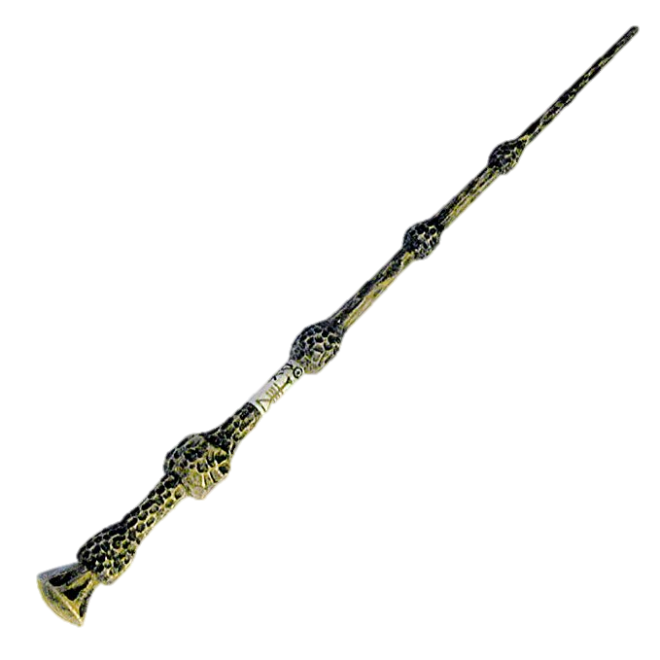
Decomposing a Relation
Redundancy can be removed by “chopping” the relation into pieces.
FD's are used to drive this process.
  R → W is causing the problems, so decompose SNLRWH into what relations?
Wages
Hourly_Emps2

Slide 16
Reasoning About FDs: Examples
Given some FDs, we can usually infer additional FDs:
  bookId → (publisher, author) implies bookID → publisher
  and bookID → author
  bookID → publisher and bookID → author implies bookID → (publisher, author)
  bookID → author and author → publisher implies bookID → publisher
But,
(title, author) → publisher does NOT necessarily imply that
title → publisher NOR that author → publisher

Slide 17
Reasoning About FDs: General
Generally, an FD g is implied by a set of FDs F
if g holds whenever all FDs in F hold.
F+ = closure of F:
  the set of all FDs that are implied by F.
  includes “trivial dependencies”

Slide 18
Rules of Inference
Armstrong's Axioms (X, Y, Z are sets of attributes):
  Reflexivity: If X ⊇ Y, then X → Y
  Augmentation: If X → Y, then XZ → YZ for any Z
  Transitivity: If X → Y and Y → Z, then X → Z
Sound and complete inference rules for FDs!
  using AA you get only the FDs in F+ and all these FDs.
Some additional rules (that follow from AA):
  Union: If X → Y and X → Z, then X → YZ
  Decomposition: If X → YZ, then X → Y and X → Z
  See if you can prove these!
Actually, William Ward Armstrong
Notes:
Union: X->Y
XX->XY (aug) so X->XY
XY->YZ (aug)
X->YZ (transitivity)
Decomp: X->YZ
YZ->Y (reflex)
X->Y (trans)

Slide 19
Example
Contracts(cid,sid,jid,did,pid,qty,value), and:
  C is the key: C → CSJDPQV
  Proj (J) purchases each part (P) using single contract (C): JP → C
  Dept (D) purchases at most 1 part (P) from a supplier (S): SD → P
Problem: Prove that SDJ is a key for Contracts
JP → C, C → CSJDPQV
  Imply JP → CSJDPQV
  (by transitivity) (shows that JP is a key)
SD → P
  implies SDJ → JP (by augmentation)
SDJ → JP, JP → CSJDPQV
  imply SDJ → CSJDPQV
  (by transitivity) (shows that SDJ is a key).
Q: can you now infer that SD → CSDPQV
  No
Notes:
Contract
Supplier
proJect
Dept
Part
Qty
Value

Slide 20
Attribute Closure
Computing closure F+ of a set of FDs F is hard:
  exponential in # attrs!
Typically, just check if X → Y is in F+. Efficient!
  Compute attribute closure of X (denoted X+) wrt F.
  X+ = Set of all attributes A such that X → A is in F+
    X+ := X
    Repeat until no change (fixpoint):
    for U → V ⊆ F,
    if U ⊆ X+, then add V to X+
  Check if Y is in X+
  Approach can also be used to check for keys of a relation.
    If X+ = R, then X is a superkey for R.
    Q: How to check if X is a “candidate key” (minimal)?
    A: For each attribute A in X, check if (X-A)+ = R

Slide 21
Attribute Closure (example)
R = {A, B, C, D, E}
F = { B →CD, D → E, B → A, E → C, AD →B }
Is B → E in F⁺ ?
B+ = {B, C, D, E, …}
… Yep!
Is D a key for R?
  D⁺ = {D, E, C}
  … Nope!
Is AD a key for R?
AD⁺ = {A, D, E, C, B}
…Yep!
Is AD a candidate key for R?
  A⁺ = {A} D⁺ = {D, E, C}
  …Yes!
Is ADE a candidate key for R?
No!

Slide 23
Thanks for that…
So we know a lot about FDs
So what?
Can they help with removing redundancy?

Slide 24
The Notion of Normal Forms
Q1: is any refinement is needed??!
If relation is in a normal form (e.g. BCNF):
  we know certain problems are avoided/minimized.
  helps decide whether decomposing relation is useful.
Consider a relation R with 3 attributes, ABC.
  No (non-trivial) FDs hold: No redundancy here.
  Given A → B: If A is not a key, then several tuples could have the same A value, and if so, they'll all have the same B value!

Slide 25
Basic Normal Forms
1st Normal Form – all attributes atomic
  I.e. relational model
  Violated by many common data models
    Including XML, JSON, various OO models
  Some of these “non-first-normal form” (NFNF) quite useful in various settings
    especially in update-never settings like data transmission
    if you never “unnest”, then who cares!
      basically relational collection of structured objects
1st ⊃ 2nd (of historical interest)
⊃ 3rd (of historical interest)
⊃ Boyce-Codd …

Slide 26
Boyce-Codd Normal Form (BCNF)
Reln R with FDs F is in BCNF if, for all X → A in F+
  A ⊆ X (called a trivial FD), or
  X is a superkey for R.
In other words: “R is in BCNF if
the only non-trivial FDs over R are key constraints.”

Slide 27
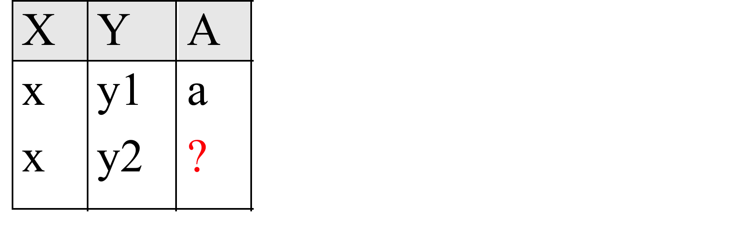
Why is BCNF Useful?
If R in BCNF, every field of every tuple records
useful info that cannot be inferred via FDs.
  Say we know FD X → A holds for this example relation:
  Can you guess the value of the missing
  attribute
  Yes, so relation is not in BCNF

Slide 29
Decomposition of a Relation Scheme
How to normalize a relation?
  decompose into multiple normalized relations
Suppose R contains attributes A1 ... An.
A decomposition of R consists of replacing R by two or more relations such that:
  Each new relation scheme contains a subset of the attributes of R, and
  Every attribute of R appears as an attribute of at least one of the new relations.

Slide 30
Example (same as before)
Hourly_Emps
SNLRWH has FDs S → SNLRWH and R → W
Q: Is this relation in BCNF?
  No, The second FD causes a violation;
  W values repeatedly associated with R values.

Slide 31
Decomposing a Relation, Part 2
Easiest fix is to create a relation RW to store these associations, and to remove W from the main schema:
Q: Are both of these relations are now in BCNF?
Yes! S → SNLRH is OK, as is R → W.
Wages
Hourly_Emps2

Slide 32
Problems with Decompositions
There are three potential problems to consider:
  1) May be impossible to reconstruct the original relation! (Lossiness)
    Fortunately, not in the SNLRWH example.
  2) Dependency checking may require joins.
    Fortunately, not in the SNLRWH example.
  3) Some queries become more expensive.
    e.g., How much does Guldu earn?
Tradeoff: Must consider these 3 vs. redundancy.

Slide 34
Lossless Decomposition (example)
Wages
Hourly_Emps2
=

Slide 35
Lossy Decomposition (example)
A → B; C → B
=

Slide 36
Lossless Join Decompositions
Defn: Decomposition of R into X and Y is lossless-join w.r.t. a set of FDs F if, for every instance r that satisfies F:
  π_{x}(r) ⋈ π_{Y}(r) = r
It is always true that r ⊆ π_{x}(r) ⋈ π_{x}(r)
  When the relation is equality, the decomposition is lossless-join.
Definition easily extended to decomposition into 3 or more relations
It is essential that all decompositions used to deal with
redundancy be lossless!
(Avoids Problem #1)

Slide 37
More on Lossless Decomposition
Theorem: The decomposition of R into X and Y is lossless with respect to F if and only if the closure of F contains:
  X ∩ Y → X, or
  X ∩ Y → Y
  From example: decomposing ABC into AB and BC is lossy, because their intersection
  (i.e., B) is not a key of either resulting relation.
Useful corollary: If X → Z holds over R and X ∩ Z is empty then
decomposition of R into R-Z and XZ is loss-less (b/c X is a superkey of XZ!)
Just like our BCNF example!
Where X is Rating, Z is Wage.
Clearly Rating intersect Wage is empty.
So decompose into SNLRH and RW and it is lossless.

Slide 38
Lossless Decomposition? Yes, but…
A → B; C → B
=
But, now we can't check A → B without doing a join!

Slide 40
Dependency Preserving Decomposition
Dependency preserving decomposition (Intuitive):
  A decomposition where the following is true:
    If R is decomposed into X, Y and Z,
    and we enforce FDs individually on each of X, Y and Z,
    then all FDs that held on R must also hold on result.
    (Avoids Problem #2 on our list.)
Defn: Projection of set of FDs F :
  If R is decomposed into X and Y the projection of F on X (denoted F_{X} )
  is the set of FDs U → V in F+
  such that all of the attributes U, V are in X.
F+: closure of F , not just F!

Slide 41
Dependency Preserving Decompositions: Definition
Defn: Decomposition of R into X and Y is
dependency preserving if (F_{X} ∪ F_{Y} ) ⁺ = F ⁺
  i.e., if we consider only dependencies in the closure F ⁺ that can be checked in X without considering Y, and in Y without considering X, these imply all dependencies in F ⁺.
  (just the formalism of our intuition above)

Slide 42
Dependency Preservation: Notes
Critical to consider F ⁺ in the definition:
  ABC, A → B, B → C, C → A, decomposed into AB and BC.
  Is this dependency preserving? Is C → A preserved?????
Well… F ⁺ contains F ∪ {A → C, B → A, C → B}, so…
  F_{AB} ⊇ {A →B, B → A}; F_{BC} ⊇ {B → C, C → B}
  So, (F_{AB} ∪ F_{BC})⁺ ⊇ {B → A, C → B}
  Hence (F_{AB} ∪ F_{BC})⁺ ⊇ {C → A}
(F_{X} ∪ F_{Y} ) ⁺ = F ⁺

Slide 43
Decomposition into BCNF
Consider relation R with FDs F.
If X → Y violates BCNF, decompose R into R - Y and XY (guaranteed to be loss-less).
  Repeated application of this idea will give us a collection of relations that are in BCNF
  Lossless join decomposition, and guaranteed to terminate.
e.g., CSJDPQV, key C, JP → C, SD → P, J → S
  {contractid, supplierid, projectid,deptid,partid, qty, value}
  To deal with SD → P, decompose into SDP, CSJDQV.
  To deal with J → S, decompose CSJDQV into JS and CJDQV
  So we end up with: SDP, JS, and CJDQV
Note: several dependencies may cause violation of BCNF.
The order in which we “deal with” them could lead to very different
sets of relations!

Slide 44

BCNF and Dependency Preservation
In general, there may not be a dependency preserving decomposition into BCNF.
E.g., CSZ, CS → Z, Z → C
  Can't decompose while preserving 1st FD; not in BCNF.
Similarly, decomposition of CSJDPQV into
SDP, JS and CJDQV is not dependency preserving
(w.r.t. the FDs JP → C, SD → P and J → S).
  However, it is a lossless join decomposition.
  In this case, adding JPC to the collection of relations gives us a dependency preserving decomposition.
    but JPC tuples are stored only for checking the f.d. (Redundancy!)

Slide 46
Third Normal Form (3NF)
Reln R with FDs F is in 3NF if, for all X → A in F⁺
  A ∈ X (called a trivial FD), or
  X is a superkey of R, or
  A is part of some candidate key (not superkey!) for R.
  (sometimes stated as “A is prime”)
If R is in BCNF, obviously in 3NF.
If R is in 3NF, some redundancy is possible.
It is a compromise, used when BCNF not achievable
  (e.g., no “good” decomp, or performance considerations).
  Lossless-join, dependency-preserving decomposition of R into a
  collection of 3NF relations always possible.
Notes:
Minimality of a candidate key is crucial in third condition above!

Slide 47

Upshot on Third Normal Form
More in the following slides, but the bottom line is:
  3NF doesn’t really make any sense.
Because you will hear about it anyhow in your job?
Nonsense, yes, but Lossless-Join & Dependency Preserving nonsense!
So why do we learn it?
Because old people liked to say “the key, the whole key and nothing but the key, so help me Codd.”
No, seriously.

Slide 48
What Does 3NF Achieve?
If 3NF violated by X → A, we can look at only two possible cases:
  X is a subset of some key K (“partial dependency”)
    We store (X, A) pairs redundantly.
    e.g. Reserves SBDC (C is for credit card) with key SBD and S → C
  X is not a proper subset of any key. (“transitive dep.”)
    There is a chain of FDs K → X → A, which means that we cannot associate an X value with a K value unless we also associate an A value with an X value (different K's, same X implies same A!) – problem with initial SNLRWH example.
But: even if R is in 3NF, these problems could arise.
  e.g., Reserves SBDC
  S → C, C → S is in 3NF (why?),
  but for each reservation of sailor S, same (S, C) pair is stored.
Thus, 3NF is indeed a compromise relative to BCNF.

Slide 49
Decomposition into 3NF
Obviously, the algorithm for lossless join decomp into BCNF can be used to obtain a lossless join decomp into 3NF (typically, can stop earlier) but does not ensure dependency preservation.
To ensure dependency preservation, one idea:
  If X → Y is not preserved, add relation XY.
  Problem is that XY may violate 3NF! e.g., consider the addition of CJP to `preserve' JP → C. What if we also have J → C ?
Refinement: Instead of the given set of FDs F, use a minimal cover for F.

Slide 50
Minimal Cover for a Set of FDs
Minimal cover G for a set of FDs F:
  Closure of F = closure of G.
  Right hand side of each FD in G is a single attribute.
  If we modify G by deleting an FD or by deleting attributes from an FD in G, the closure changes.
Intuitively, every FD in G is needed, and ``as small as possible'' in order to get the same closure as F.
e.g., A → B, ABCD → E, EF → GH, ACDF → EG has the following minimal cover:
  A → B, ACD → E, EF → G and EF → H
M.C. implies Lossless-Join, Dep. Pres. Decomp!!!
  (in book)

Slide 52
Summary of Schema Refinement
BCNF: each field contains data that cannot be inferred via FDs.
  ensuring BCNF is a good heuristic.
Not in BCNF? Try decomposing into BCNF relations.
  Must consider whether all FDs are preserved!

Slide 53
Summary of Schema Refinement, cont
What to do when a lossless-join, dependency preserving decomposition into BCNF is impossible?
  There is a more permissive Third Normal Form (3NF)
    In the hidden slides of slide deck, or book, or Wikipedia
  But you’ll have redundancy. Beware. You will need to keep it from being a problem in your application code.
Note: even more restrictive Normal Forms exist
  we don't cover them in this course, but some are
  in the book

